Slide 1
Difference in two means

Slide 2

Diamonds
Weights of diamonds are measured in carats. The difference between the size of a 0.99 carat diamond and a 1 carat diamond is undetectable to the naked human eye, but does the price of a 1 carat diamond tend to be higher than the price of a 0.99 diamond?
In order to be able to compare equivalent units, we divide the prices of 0.99 carat diamonds by 99 and 1 carat diamonds by 100, and compare the average point prices. Assume the point prices are normally distributed.

Slide 3
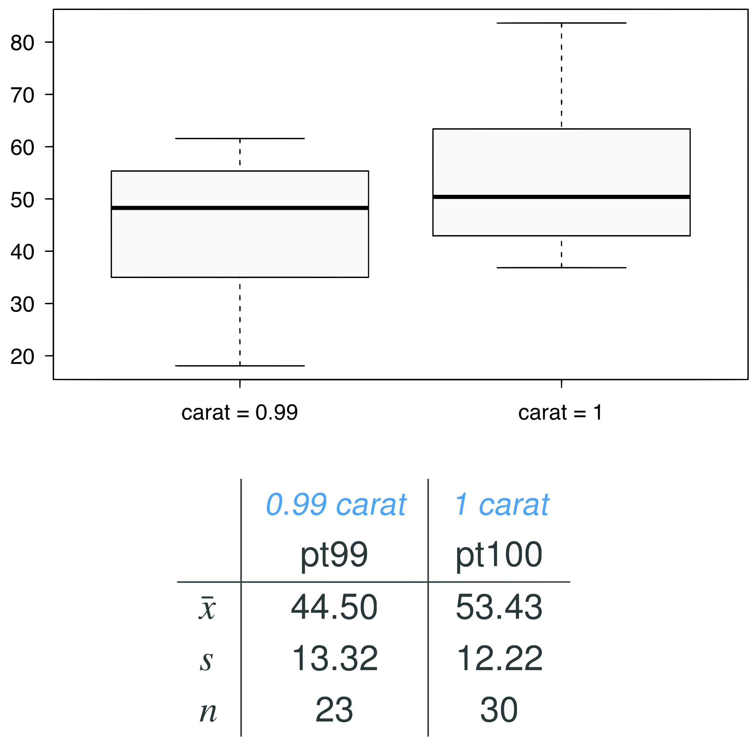
Data
Note: These data are a random sample from the diamonds data set in ggplot2 R package.

Slide 4


Parameter and point estimate
Parameter of interest: Average difference between the point prices of all 0.99 carat and 1 carat diamonds
Point estimate: Average difference between the point prices of sampled 0.99 carat and 1 carat diamonds

Slide 5
Hypotheses
We are testing if the average point price of 1 carat diamonds (pt100) is higher than the average point price of 0.99 carat diamonds (pt99)?
H₀ : 𝞵_{pt99} - 𝞵_{pt100} = 0
H_{A} : 𝞵_{pt99} - 𝞵_{pt100} < 0

Slide 6
Conditions
Independence
Sample size or Normality

Slide 7
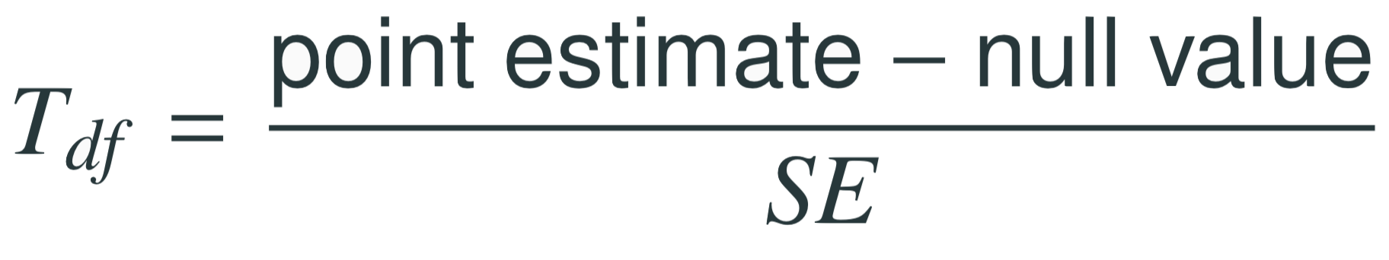
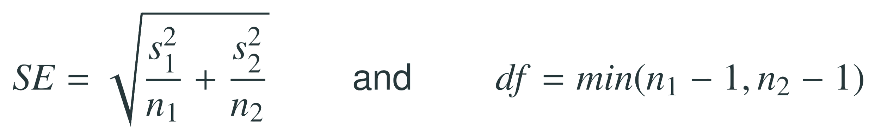
Test statistics
The test statistic for inference on the difference of two means where σ₁ and σ₂ are unknown is the T statistic.
where
Note: The calculation of the df is actually much more complicated. For simplicity we’ll use the above formula to estimate the true df when conducting the analysis by hand

Slide 8
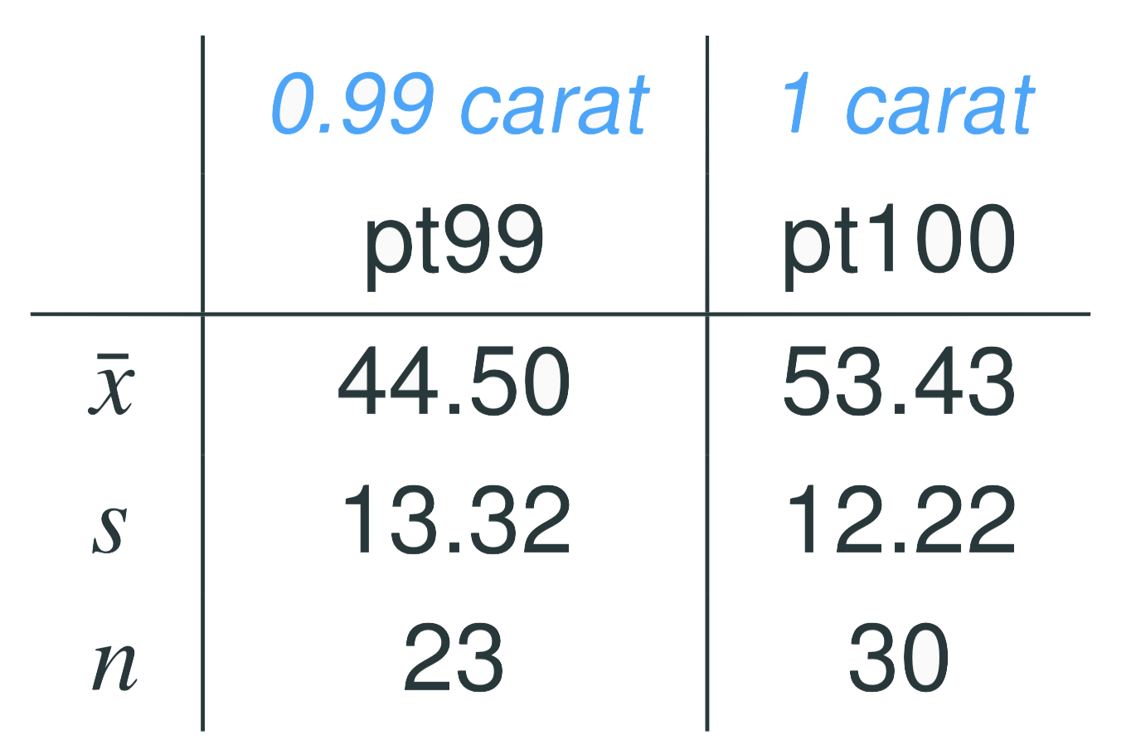
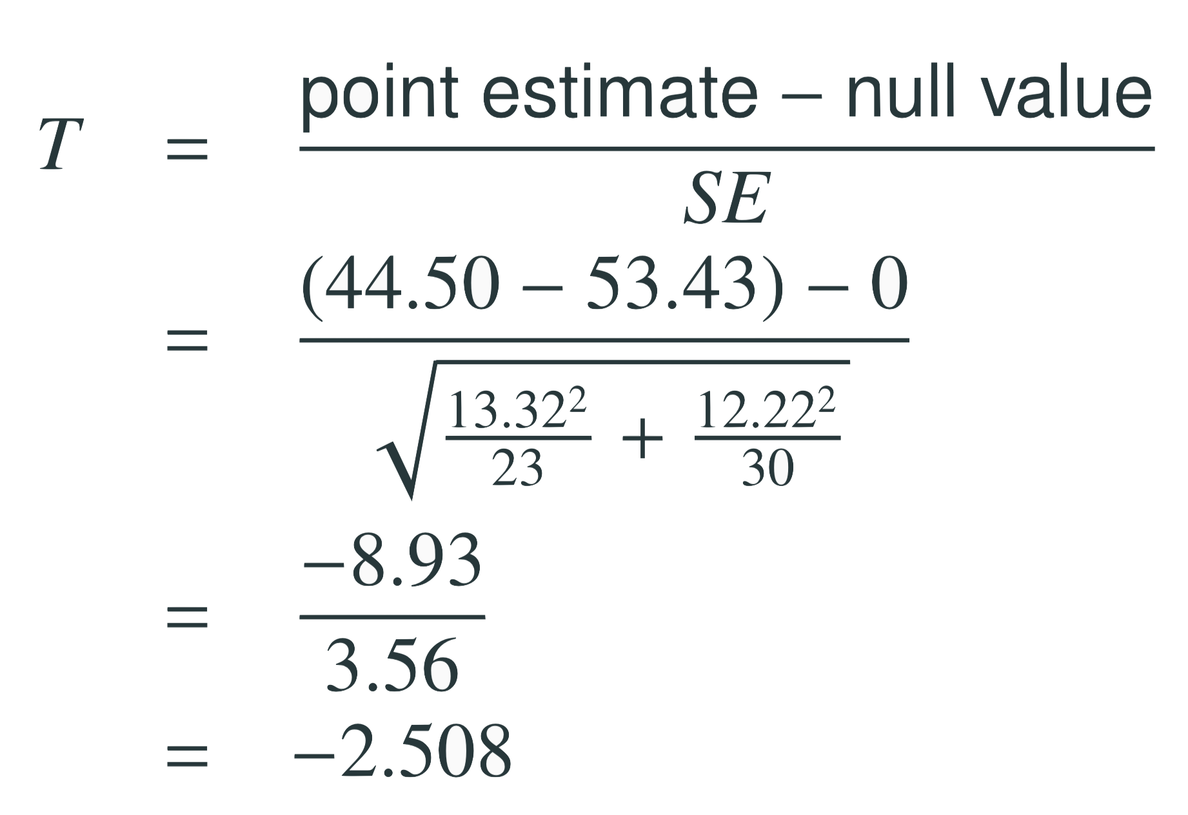
Test statistics (cont.)
In context...

Slide 9
Test statistics (cont.)
In context...

Slide 10



Test statistics (cont.)
Which of the following is the correct df for this hypothesis test?
22
23
30
29
52

Slide 11


p-value
Which of the following is the correct p-value for this hypothesis test?
between 0.005 and 0.01
between 0.01 and 0.025
between 0.02 and 0.05
between 0.01 and 0.2

Slide 12
p-value
Which of the following is the correct p-value for this hypothesis test?
between 0.005 and 0.01
between 0.01 and 0.025
between 0.02 and 0.05
between 0.01 and 0.2
> pt(q = -2.508, df = 22)
[1] 0.0100071

Slide 13
Conclusion
What is the conclusion of the hypothesis test? How (if at all) would this conclusion change your behavior if you went diamond shopping?
p-value is smaller than α (0.05) so reject H₀. The data provide convincing evidence to suggest that the point price of 0.99 carat diamonds is lower than the point price of 1 carat diamonds.
Maybe buy a 0.99 carat diamond? It looks like a 1 carat, but is significantly cheaper.

